Slide 1
CSE 499B
Section - 12
Group - 03
Group - 03
Md. Kamrul Islam | Farhan Ishraque | Iram shehzad | Atikul Islam Nahid

Slide 2
Literature review
Group - 03
Md. Kamrul Islam | Farhan Ishraque | Iram shehzad | Atikul Islam Nahid

Slide 3
ABOUT US
Md. Kamrul Islam
2211745642
Farhan Ishraque
2212002042
Atikul Islam Nahid
2211978042
Iram shehzad
2131614642
Group - 03
Md. Kamrul Islam | Farhan Ishraque | Iram shehzad | Atikul Islam Nahid

Slide 4
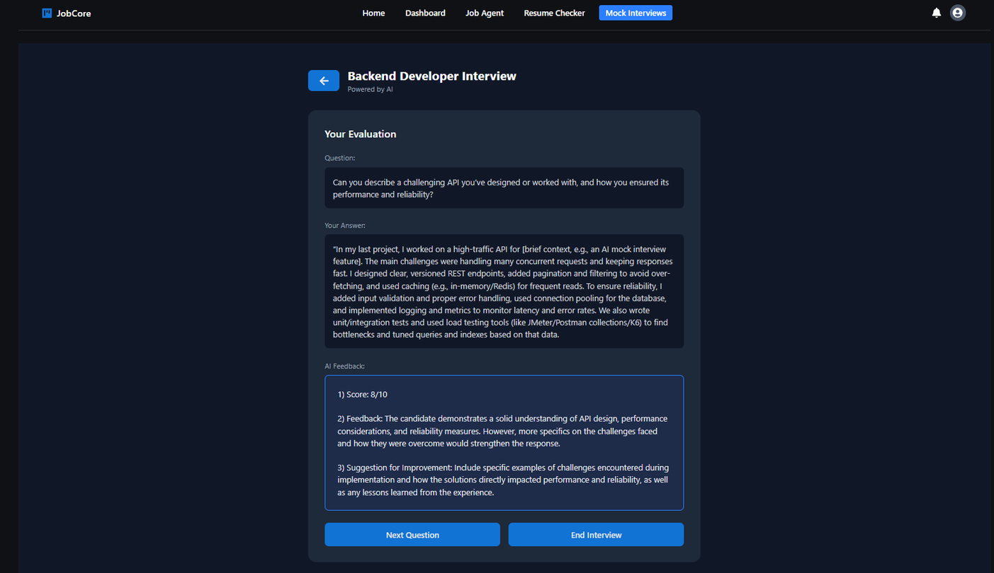
WHAT WE HAVE DONE
AI Mock
Interview
Group - 03
Md. Kamrul Islam | Farhan Ishraque | Iram shehzad | Atikul Islam Nahid

Slide 5
EVOLUTION OF MOCK INTERVIEW
Basic question generation using text generation models.
Effective candidate selection according to the job position.
Uses Vosk for offline transcription and local storage.
Group - 03
Md. Kamrul Islam | Farhan Ishraque | Iram shehzad | Atikul Islam Nahid

Slide 6
WHAT WE ADDRESS GAPS
Weakness-Driven Dynamic Difficulty Adjustment Framework
Group - 03
Md. Kamrul Islam | Farhan Ishraque | Iram shehzad | Atikul Islam Nahid

Slide 7
WHAT WE READ
Towards Smarter Hiring: Are Zero-Shot and Few-Shot Pre-trained LLMs
Ready for HR Spoken Interview Transcript Analysis?
Virtual Interviewers, Real Results: Exploring AI-Driven Mock Technical Interviews on Student Readiness and Confidence
MockLLM: A Multi-Agent Behavior Collaboration Framework for
Online Job Seeking and Recruiting
AI-Based Interview Coach: A Privacy-Preserving Offline System for Student Interview Preparation
Group - 03
Md. Kamrul Islam | Farhan Ishraque | Iram shehzad | Atikul Islam Nahid

